Slide 1
First checkpoint
The Web

Slide 2
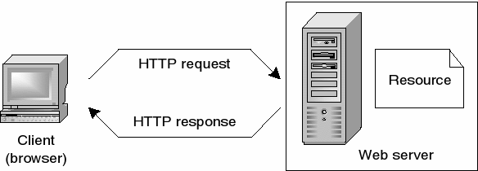
How does the web work?
Web servers and web browsers communicate via HTTP
HTTP ensures that all parts of the web page are delivered
Web browser decides how these items are displayed
The backbone of the web is the network of webservers across the world. These are really just computers that have a particular type of software running on them - software that knows how to speak the HTTP protocol and knows which information stored on the computer should be made accessible through the web.
Image 1 : How HTTP works

Slide 3
What do you need to be a web developer?
To become a Web Developer, you should have an understanding of HTML, CSS, and JavaScript. It’s also recommended to learn about CSS and CSS frameworks. Developing these fundamental web development skills will give you the foundation and logic for communicating with programming languages.
How to become a Web Developer in five steps:
Learn web development fundamentals
Choose a development specialization
Learn key programming languages for web development
Work on projects to develop your Web Developer skills
Build a web development portfolio

Slide 4
Why did I choose to learn web development?
I choose to learn web development because :
Web developers are in high demand
Web developers can work in many types of companies
Web developers are shaping the future

